Slide 1
CPSC 457
Introduction, History, Basic concepts
Contains slides from Mea Wang, Andrew Tanenbaum and Herbert Bos

Slide 2
Outline
attempt to define OS
brief history of OSes
Chapter 1 of the book

Slide 3
Defining an OS
no 'precise' definition
it is a layer of software that provides application programs with a better, simpler, cleaner, model of the computer (hardware)
it manages all resources
it is the software that runs all the time (mostly in kernel mode)
all other applications need it in order to run
we can look at an OS from two different perspectives:
as an extended machine
as a resource manager

Slide 4
OS - an extended machine
abstraction/generalization is key to managing complexity
first we define and implement the abstractions
eg. files - working with files is easier than dealing with raw disk space
then we use these abstractions to write applications and solve problems
e.g. file editor, image viewer
the abstractions allow us to mask the ugly hardware and provide nice interfaces instead
many OS concepts are abstractions
some similarity to OO (pure virtual class, interface)
Applications
nice interface
Operating system
ugly interface
Hardware

Slide 5
OS - a resource manager
resource allocator
multiplex resources
multiplex in time
eg. 3 programs trying to print to the same printer (spooling)
eg. 2 programs trying to run at the same time (scheduling)
multiplex in space
eg. 2 programs allocating memory
manage conflicts among multiple programs or users
control program
controls execution of programs
prevent errors and improper use
OS is responsible for handling all interrupts and traps

Slide 6
History of OSes
When was the first OS invented?
1930s
1950s
1970s
1990s

Slide 7
History of operating systems
When was the first OS invented?
1930s
1950s
1970s
1990s
OSes often developed by customers instead of HW manufacturers
IBM developed first OS in the 60's

Slide 8
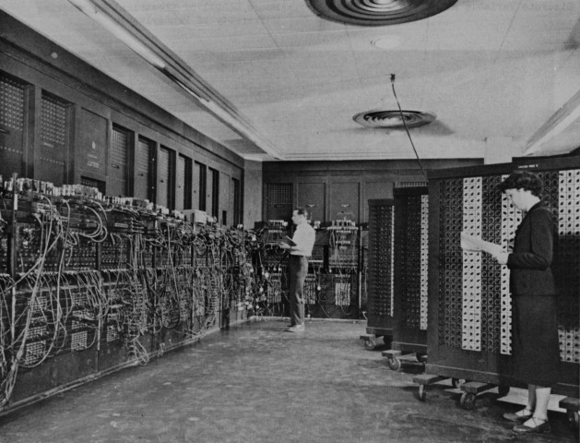
History of operating systems
1st generation (1945 - 1955): Vacuum Tubes and no OS
programs hard-wired, later on punch cards
written in machine language
HW with complicated wiring
designers = builders = programmers
only basic numerical calculations
one user/application at a time
no OS (no need)

Slide 9
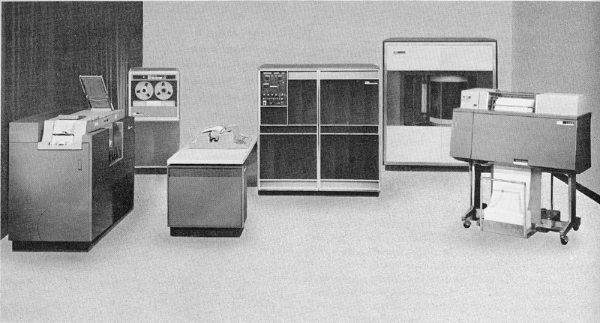
History of operating systems
2nd generation (1955 - 1965): Transistors and Batch Systems
mainframe computers
FORTRAN & COBOL programs on punch cards
OSes: FMS (Fortran Monitor System) and IBSYS (IBM’s OS)
important concepts: batch systems

Slide 10
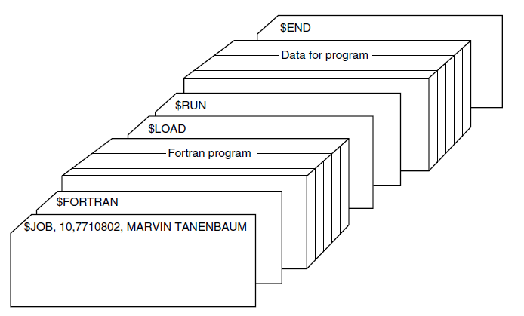
Batch systems
Structure of a typical FMS job

Slide 11
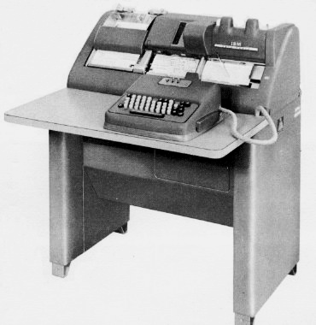
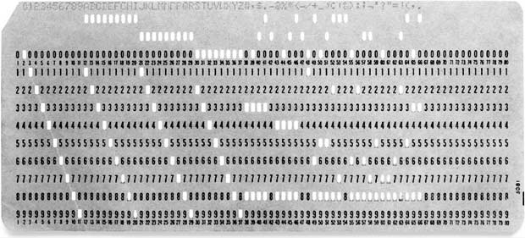
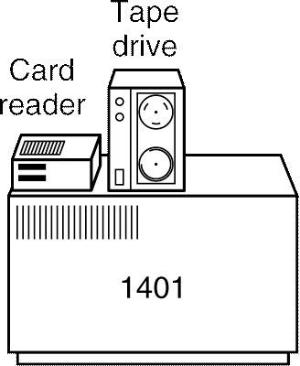
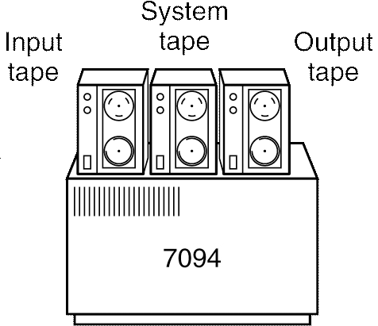
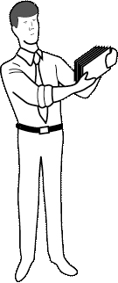
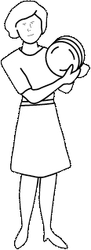
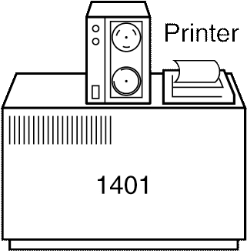


Batch systems

Slide 12
History of operating systems
3rd generation (1965 - 1980): ICs and Multiprogramming
Uses ICs (Integrated Circuits)
OSes: IBM OS/360, CTSS (by MIT), MULTICS (complicated, but influential), UNIX (inspired by Multics), and eventually Linux (90's)
Important concepts:
multiprogramming: a different job in each memory partition, CPU execute other jobs while waiting for the I/O of some jobs
spooling (Simultaneous Peripheral Operation On Line): read jobs from cards to disk, load jobs from disk automatically, no more tapes
time-sharing: multiple users using one computer simultaneously & interactively

Slide 13
Multiprogramming
Single Program
Multiprogramming
OS
OS
CPU
Programs
CPU
Programs
A
A
B
C
D

Slide 14
Running one program at a time
program 1
run
I/O
run
I/O
run
program 2
run
I/O
run
I/O
run
program 3
run
I/O
run
CPU:
p1
idle
p1
idle
p1
p2
idle
p2
idle
p2
p3
idle
p3

Slide 15
Multiprogramming
program 1
run
wait
run
wait
run
run
program 2
wait
run
wait
run
wait
program 3
wait
run
wait
run
wait
run
wait
CPU:
p1
p2
p3
p1
p3
p2
p3
p1
p1

Slide 16
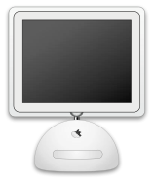
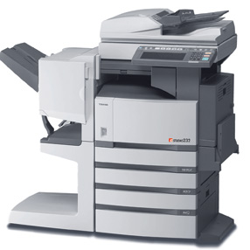
Spooling
spooling is typically used to deal with slow devices / peripherals, eg. printers:
spooling can be used (somewhat) to deal with deadlocks in concurrent programming
fast
slow
spooler
fast

Slide 17
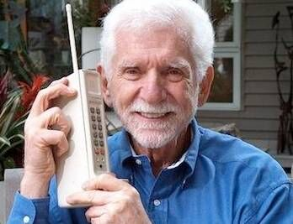
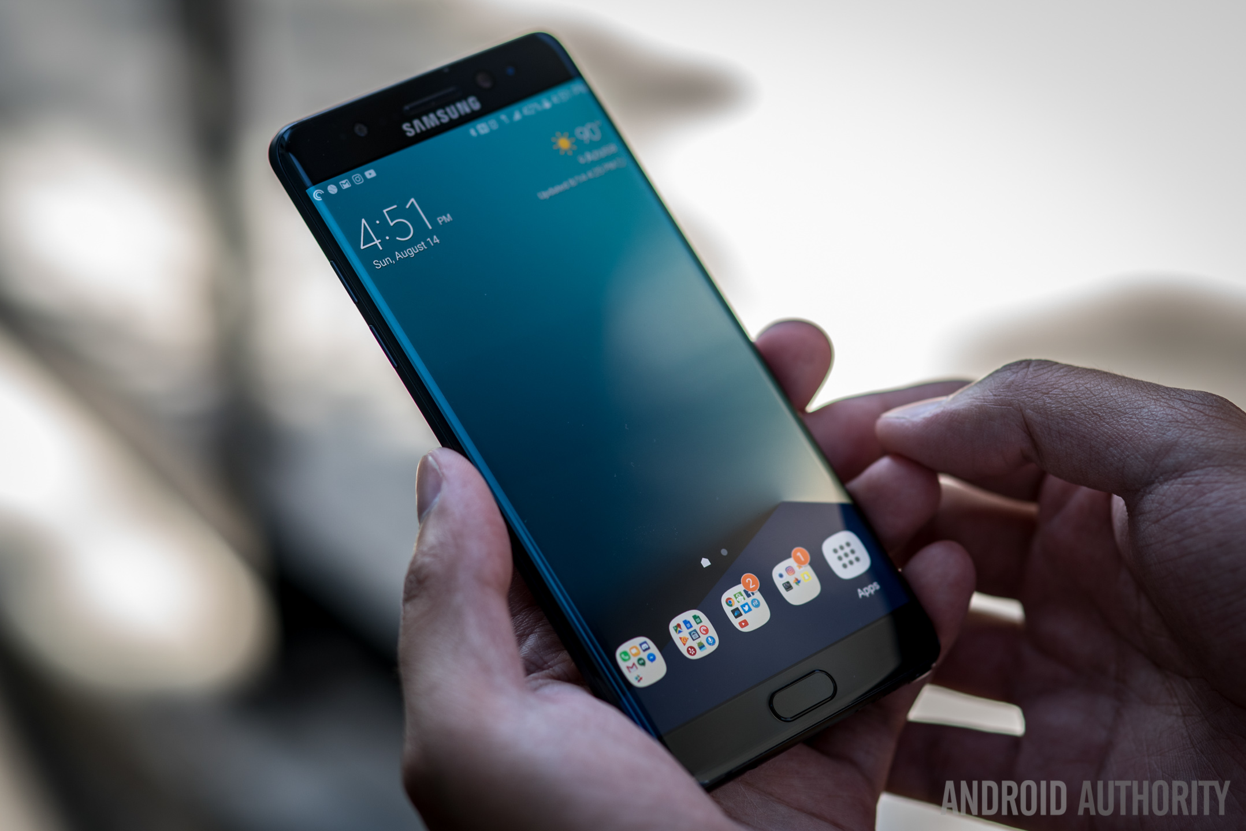
History of operating systems
4th generation (1980 - present): personal computers
cheap mass-produced computers
user friendly shells on top of OS
Windows, Mac OS, Linux + GNOME / KDE
5th generation (1990 - present): mobile computers

Slide 18
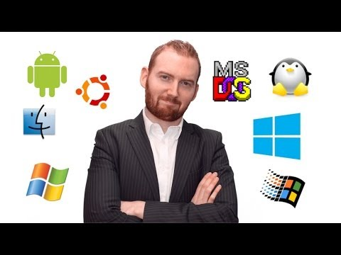
History of operating systems

Slide 19
Online resources
Computer History Museum
http://www.youtube.com/user/ComputerHistory
http://www.computerhistory.org
http://www.youtube.com/watch?v=qundvme1Tik

Slide 20
Summary
Define OS
An extended machine
A resource manager
OS history
Batch systems
Multiprogramming
Spooling
Time sharing
References:
1.1 - 1.2, 1.4 (Modern Operating Systems)
1.1 (Operating System Concepts)

Slide 21
Example question
Which of the following concepts introduced interactive service for multiple users?
batch system
multiprogramming
spooling
timesharing

Slide 22
Questions?

